Slide 1



Team Oceanus
End of Semester Presentation

Slide 2
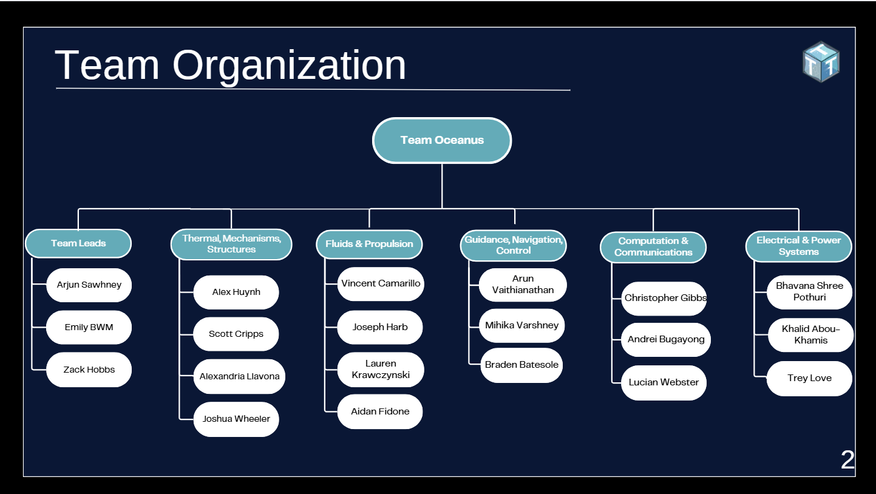
Team Organization
2

Slide 3
Timeline
Oct. 26th, 2025
Internal PDR
Dec. 2nd,
2025
EoS
January X, 2026
CDR
Nov. 16th, 2025
External PDR
Dec. 2025,
Registration Opens
3

Slide 4
2026 MATE ROV Competition
Operate between -2°C and 30°C
ROV must be able to:
Collect data
Conduct physical sampling and manipulation
Capture visual footage
Autonomous Float capable of 2 depth profiles
ROV shall cost under $5,000
ROV shall be powered by 48 or 12 V
ROV shall include at least 1 camera
ROV shall be under 35 kg
ROV shall pass through 1 x 1 m launch opening
ROV may use pneumatics and/or hydraulics
4

Slide 5

Thermals, Mechanisms, Structures (TMS)

Slide 6
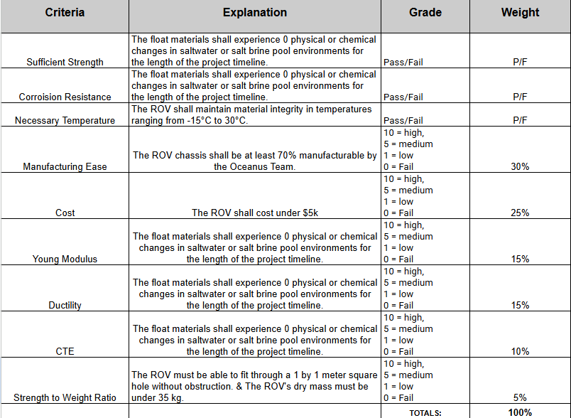
Material/Design Justification
6

Slide 7
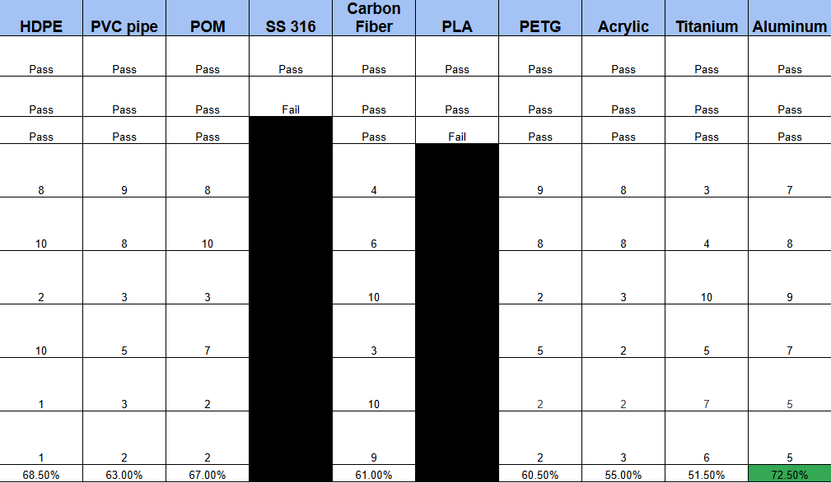
Material/Design Justification
7

Slide 8
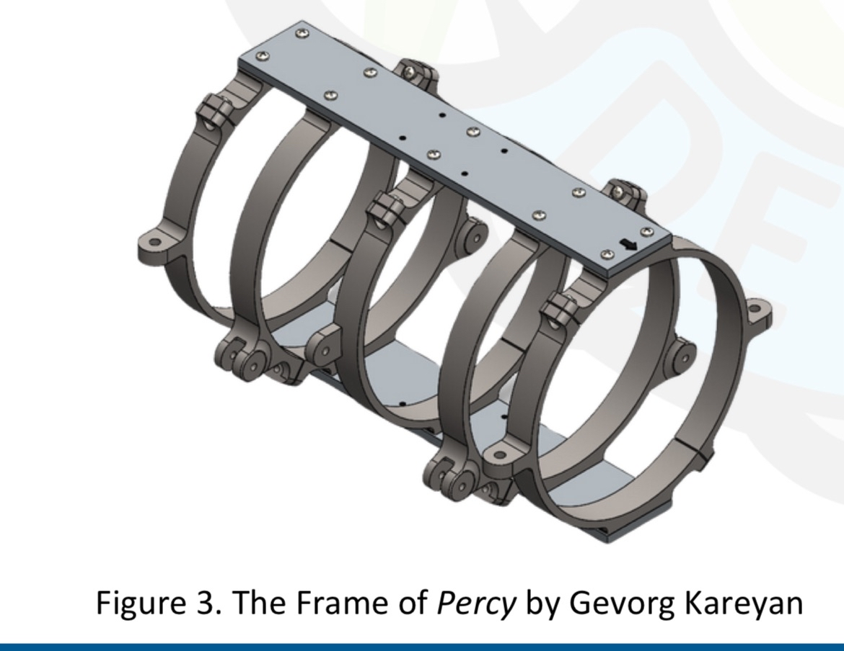
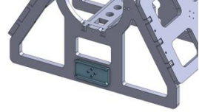
Prototype Chassis
Open Frame
Sonar Mounting Plate
Surface Area for Subteam Integration
Structural Integrity
8

Slide 9
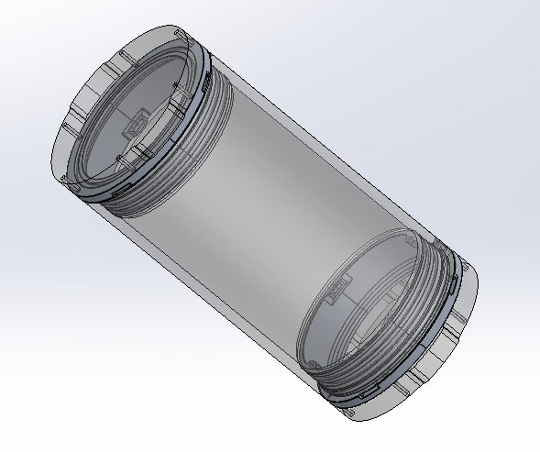
ROV/Float Electronics Housing - Thermal Regulation
Assumptions
-25 C ambient environment
20 C internal target temperature
Turbulent waters
Results (Appendix C)
~60 Watts of heating needed
(hand calculations)
~90 Watts of heating needed (thermal simulation)
Silicon heating pads and thermistors
9
Notes:
Assumptions
the worst conditions will be -25 degrees celsius. Water won’t be this cold, but the device will be exposed to the cold air for the duration of the competition day
20 C is a safe operating temperature for electronics and satisfies our requirement for thermal control
turbulent water increases rate of heat loss, important to consider
Results
See appendix for calculations to support these numbers
100 watts of heating will be sufficient given the results
silicon heating pads can conform to the inside of the enclosure, and thermistors will be necessary for regulating temperature (they’re little things that stick to a surface and measure temperature)
these electronics are new additions, so they are not currently considered by electrical subteams for power draw and wiring.

Slide 10
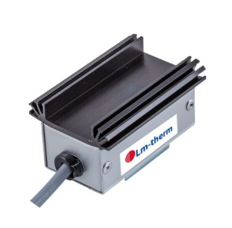
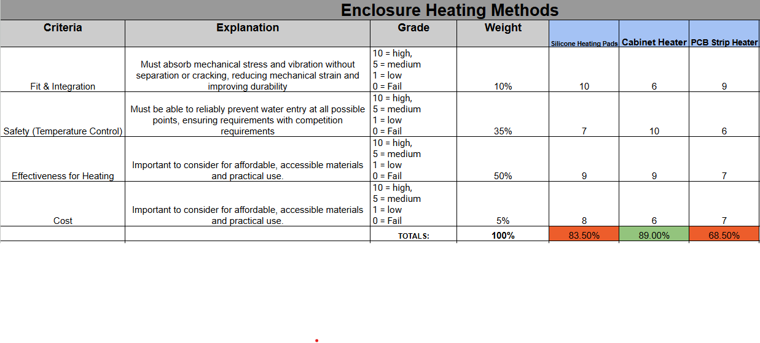
Enclosure Heating Methods
Integrated thermostat
Self regulating temperature to keep above ambient
Anti-condensation
Control Cabinet Heater Super - Mini
10

Slide 11
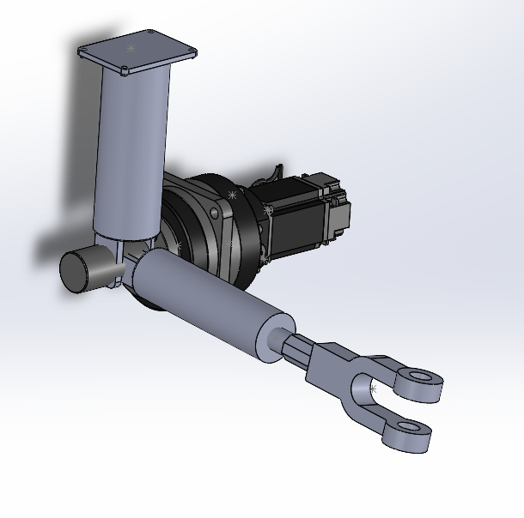
Claw Arm Design
Hinge-Joint for Arm 1-Arm 2.
Knuckle joint for Arm 2- Claw
Proportions flexible
Servo motor presented as an example:
11
Notes:
Claw material dependent on rov frame strength. Currently thinking of a combination of stainless steel and HDPE. Stainless steel for the pivot points because it is very corrosion resistant and HDPE for the claw itself or something similar to reduce the weight of the ROV. Again, we can add more stainless steel the stronger out material is and with the reduction of the first arm, we can add more as well.
Plate on the top is connected to the bottom of the robot. This plate was situation specific for last year’s competition because you could not touch the shipwreck; however, this can be adjusted to be apart of the robot if this same situation does not occur this year. The elbow, or hinge joint, would allow for upwards and downwards movement while the wrist joint would allow for either up and down movement or side to side movement (dependent on what we decide to make it based on the tasks and parts. In order to ensure the electronics are kept in the middle safe, we can add snake mesh or waterproof wrap in order to ensure flexibility and protection. (Shrink-wrap is also an option, but further research and finalized water temperature would have to be measured to see how it would affect the material and its flexibility). The arm pieces would also be adjusted in length according to the material we use (material strength), and how large the pieces, obstacles, are. The servo motor is also shown in a lot larger proportion that it

Slide 12
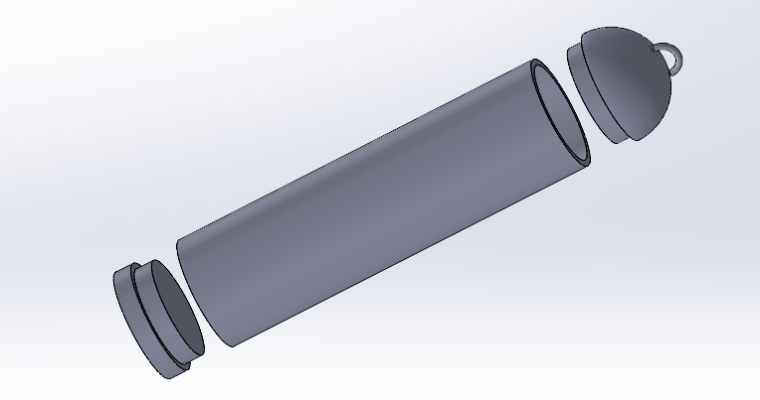
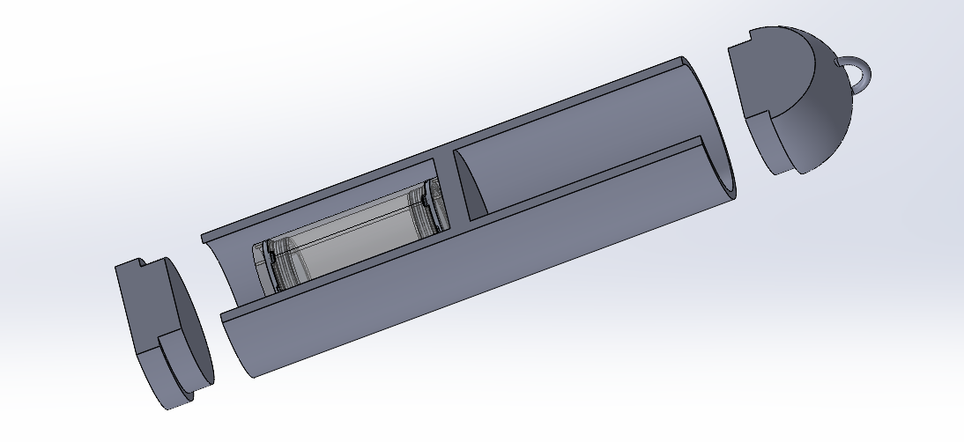
Float Housing
Dual-compartment
Mitigation of failure
Electronics below, buoyancy above
CM and CB relationship
Recovery ring on top
Rules compliance
Accessible from both ends
Silicon-sealed
18 cm diameter, 78 cm height
rules compliance
12
Notes:
Dual compartment
Having a separating piece offers both pressure resistance (by supporting the tube) and failure mitigation (if one section leaks, the other is safe)
Electronics and buoyancy placement
CM = center mass, CB = center buoyancy. Electronics below offers optimal relationship between CM and CB (say that F&P can elaborate during questions, lowkey check with them and make sure they have smth to say on this)
Recovery ring on top
rules require a method of recovery to retrieve the device
Accessibility
the end caps will utilize a silicon sealing method for waterproofing and fulfil our requirement for the device to be accessible in a reusable manner. Willing to sacrifice performance to access compartments for maintenance
Dimensions
self explanatory

Slide 13
Fluids & Propulsion (F&P)

Slide 14
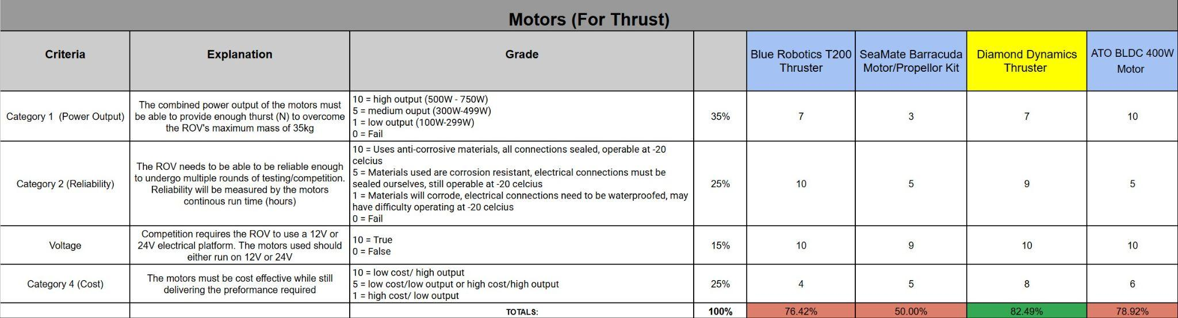
Thruster Trade Study
17

Slide 15
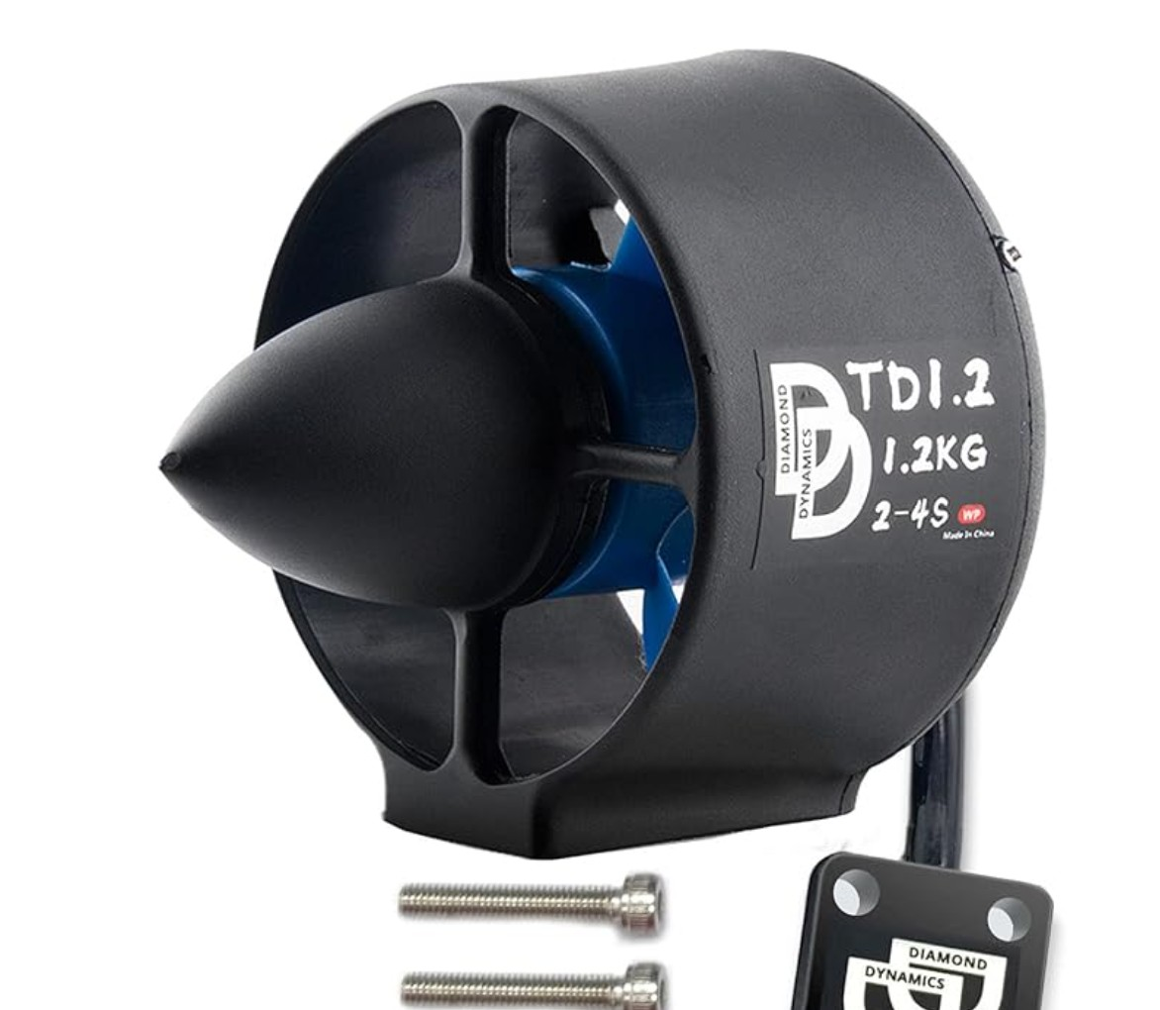
Diamond Dynamics Thruster
Pros:
Affordable
Sufficient Power
Similar to T200
Still Customizable
18

Slide 16
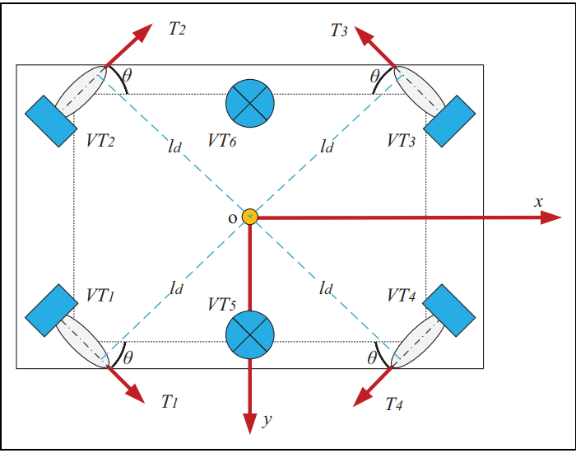
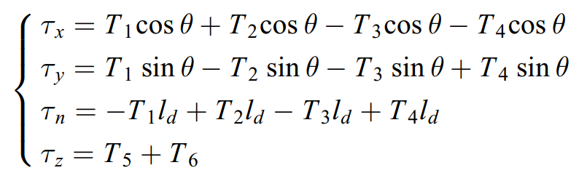
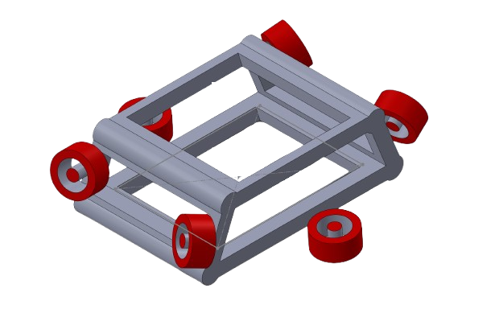
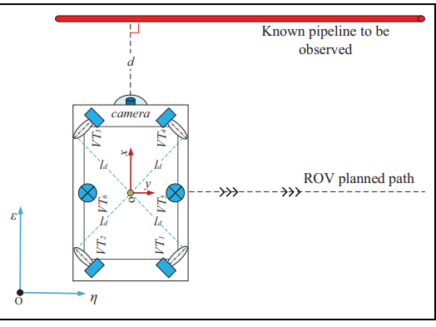
Thruster Configuration
Thrust Allocation for Flight Controls
5 DOF
19

Slide 17
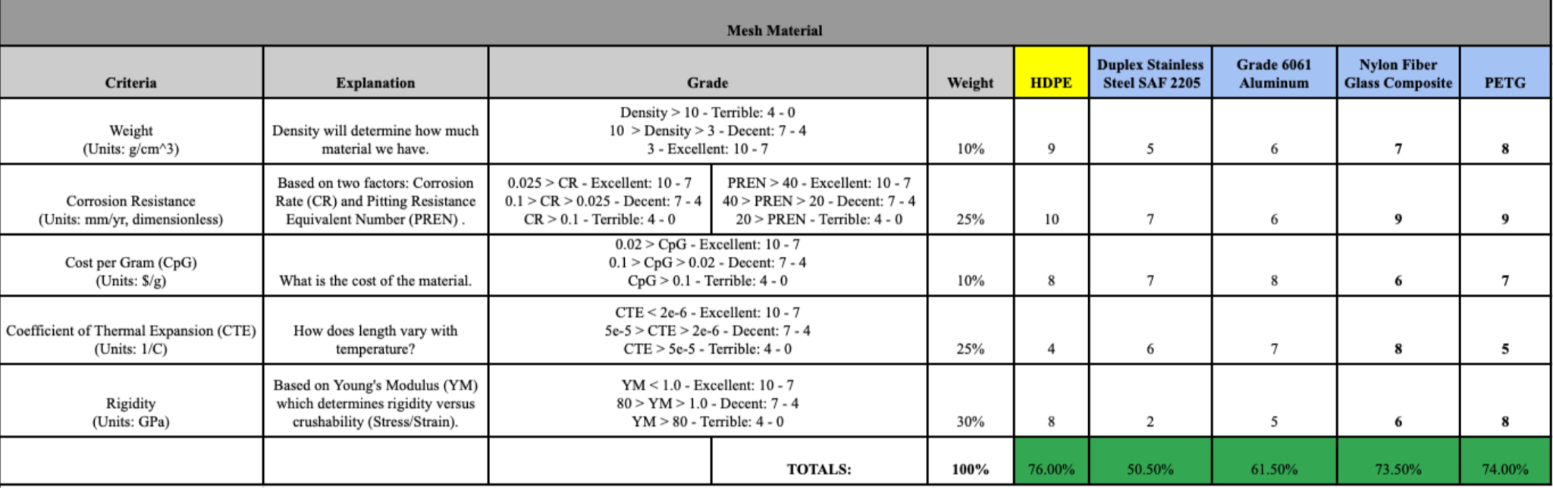
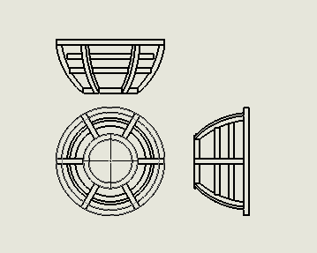
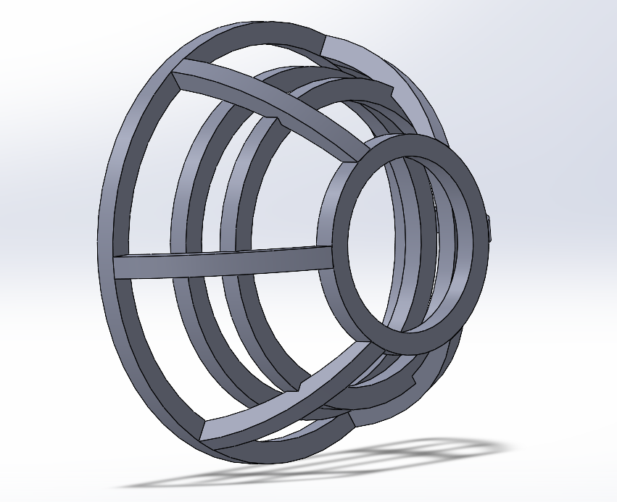
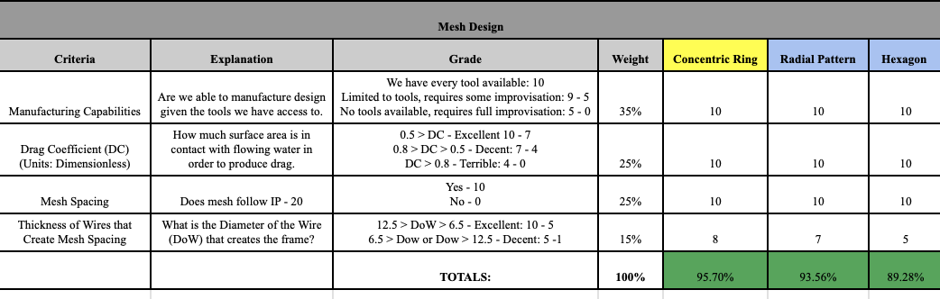
Thruster Guard Specifications
Protruding, concentric mesh 2 mm from propeller with IP-20.
Mesh will be made out of HDPE.
HDPE is compatible with Diamond Dynamics Thruster guard shroud.
Mesh has a high tolerance.
Thruster Guard Mesh Material Selection
Schematic of Mesh
3D Model of Mesh
Thruster Guard Mesh Design Considerations
20

Slide 18
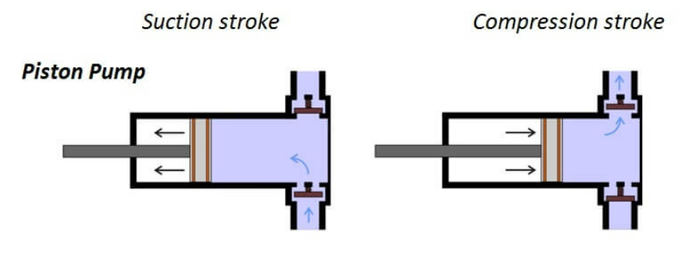
Ballast System - Tank
Ballast tank will occupy the top half of the float configuration
A positive displacement pump fixated at the top of the float will change the tanks water level and alter the buoyancy
The rov will displace a volume of 1.5L and 5L for the Float
This will ensure the ROV stability underwater
21

Slide 19
Electrical Power Systems (EPS)

Slide 20
Onboard Architecture
Criteria | Explanation | Grade | Weight | Distributed Local DC-DC Conversion | Dual-Voltage Bus | Single-Bus Centralized DC
Electrical Efficiency | Reduces resistive losses and optimizes power transfer for long tether systems. | 5 = High 3 = Medium 1 = Low 0 = Fail | 18% | 5 | 4 | 3
Safety & Fault Tolerance | Ensures system protection from faults and protects divers and electronics. |  | 18% | 5 | 4 | 3
Modularity / Scalability | Allows expansion, subsystem replacement, or upgrades easily. |  | 14% | 5 | 4 | 2
Maintenance / Serviceability | Simplifies troubleshooting and long-term upkeep. |  | 12% | 3 | 3 | 4
Weight & Space Efficiency | Reduces housing footprint and helps achieve neutral buoyancy. |  | 10% | 3 | 3 | 4
Cost & Complexity | Balances affordability and simplicity of implementation. |  | 10% | 2 | 3 | 5
Ease of Integration | Simplifies wiring, layout, and assembly during manufacturing. |  | 10% | 3 | 4 | 5
Standards / Reliability | Adheres to marine electrical standards and proven reliability. |  | 8% | 5 | 4 | 3
 |  |  | 100% | 81.2% | 73.6% | 69.6%
22

Slide 21
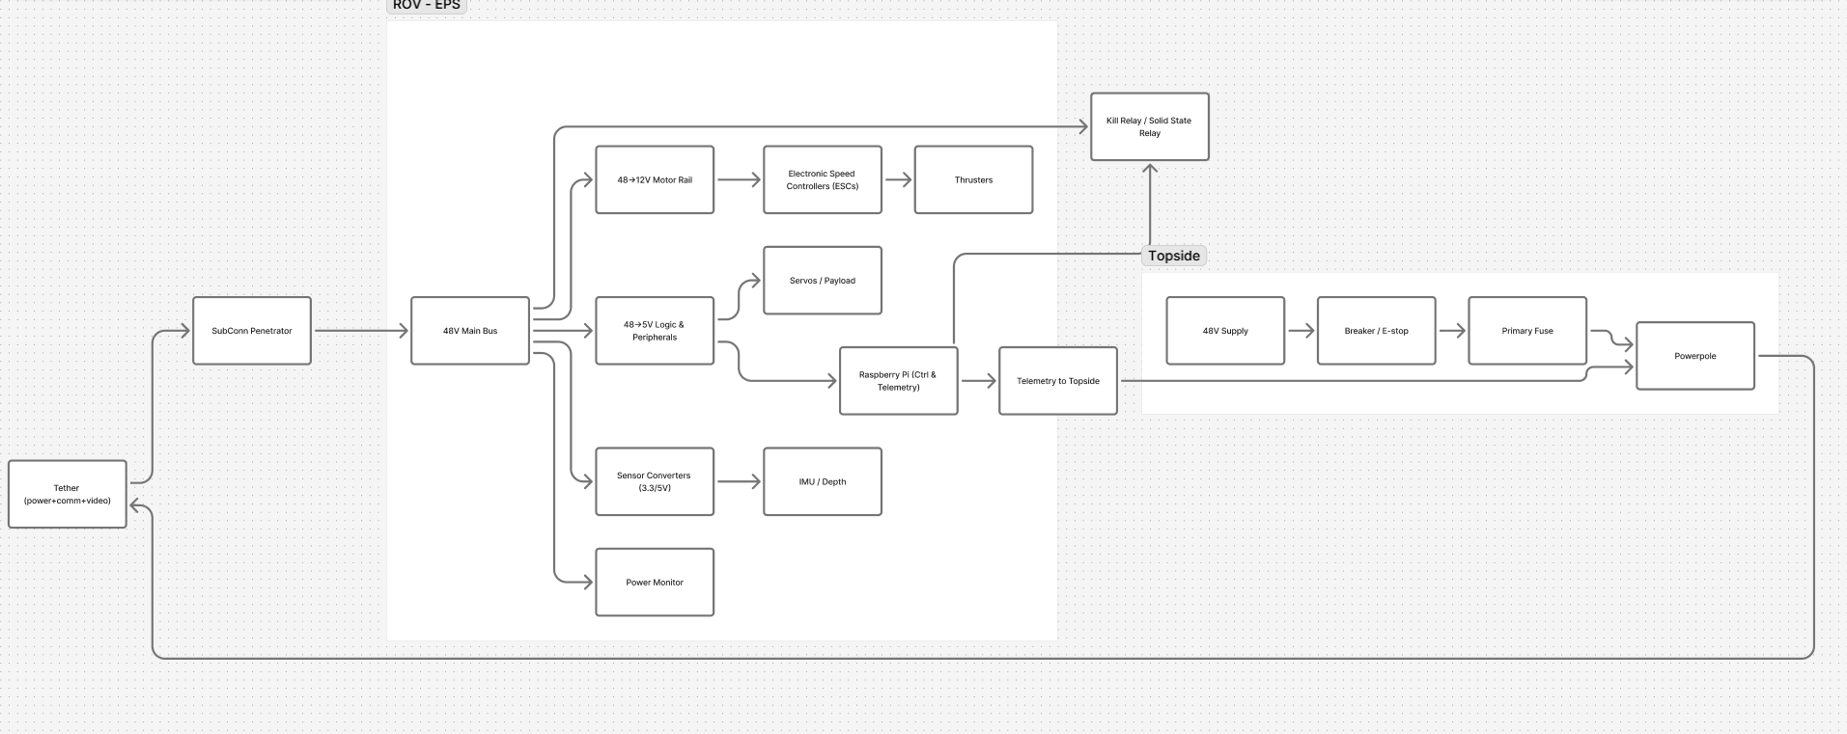
ROV/Topside Block Diagram
23

Slide 22
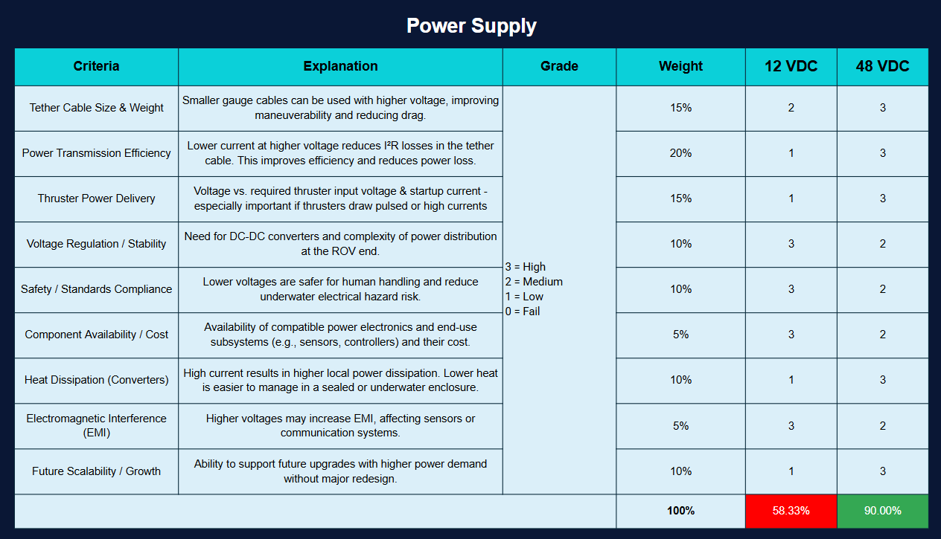
24

Slide 23
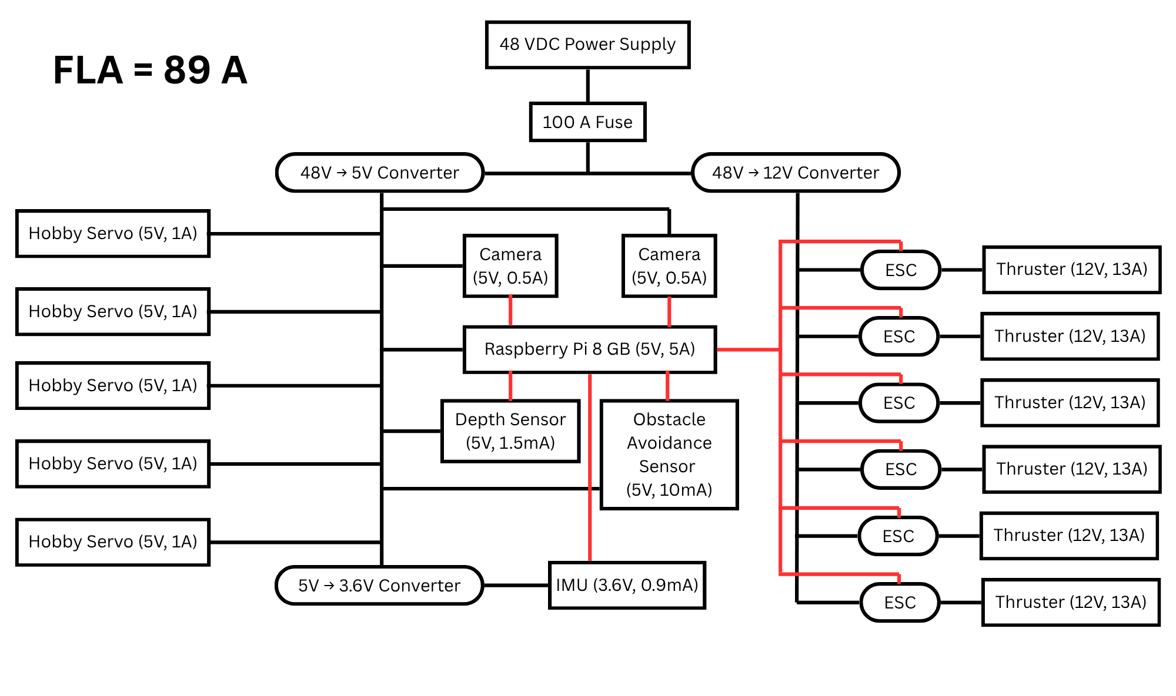
ROV Block Diagram
25

Slide 24
Guidance, Navigation, and Control (GNC)

Slide 25
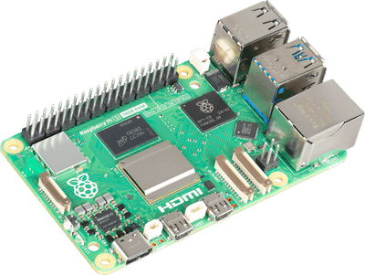
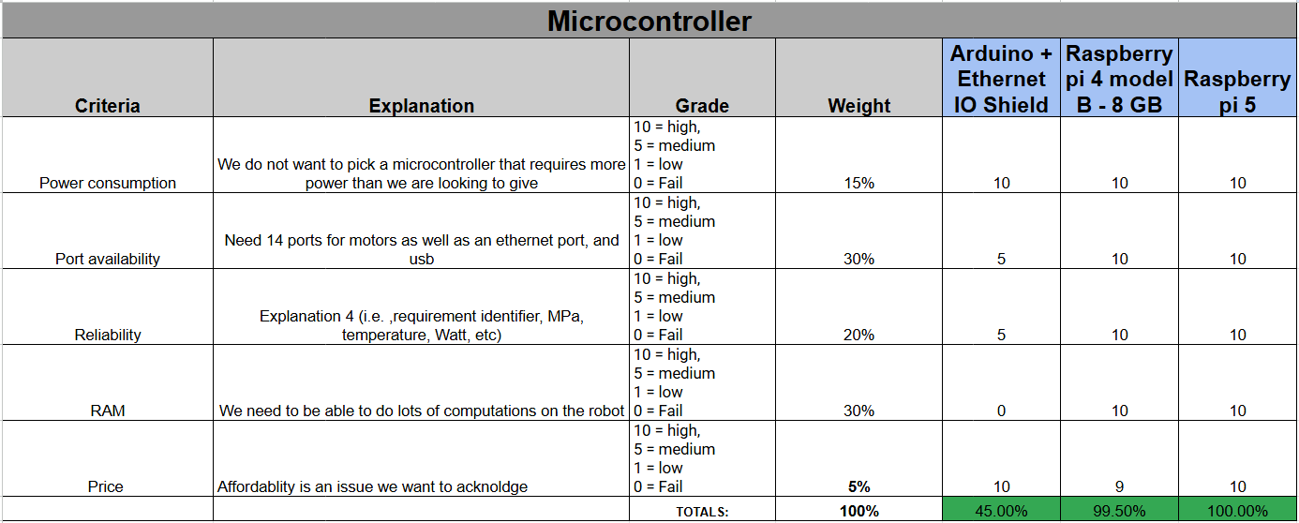
Single Board Computer (SBC)
8 GB RAM
2.4 Ghz CPU
Ethernet (1 Gbps) connectivity
Raspberry Pi 5
27

Slide 26
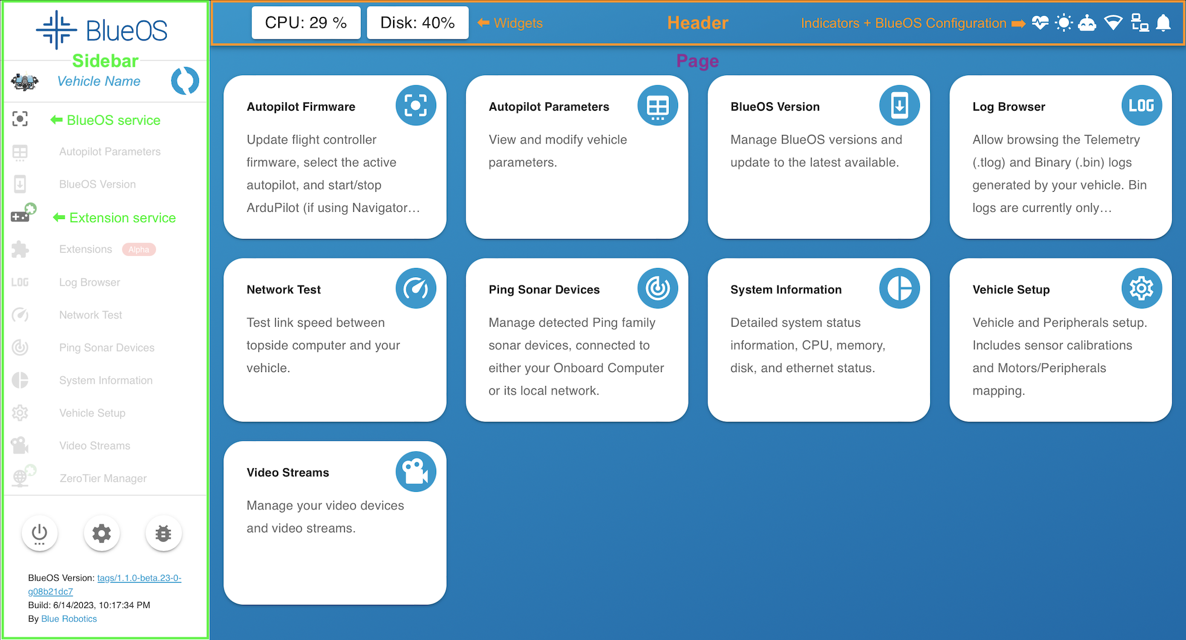

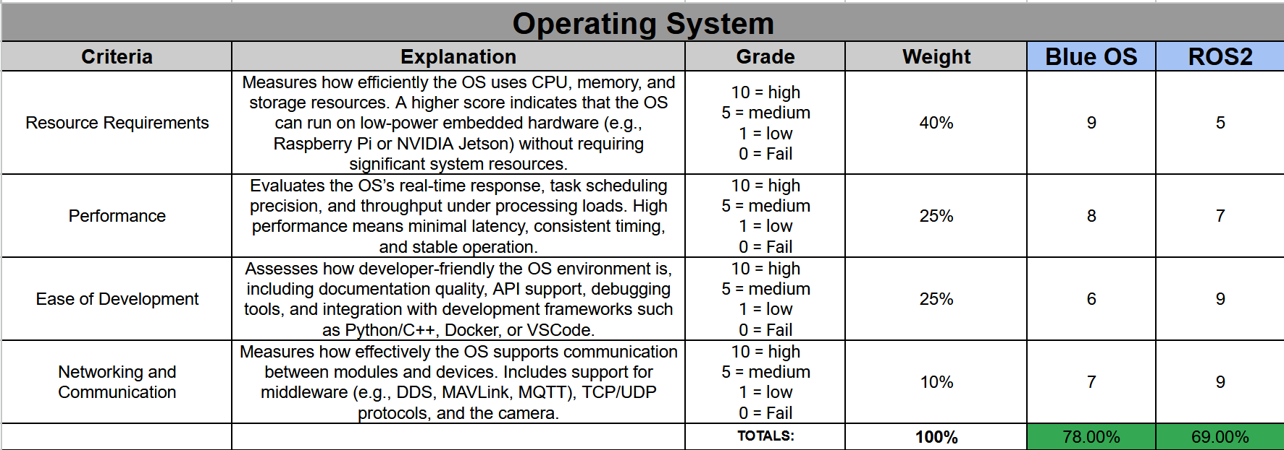
Operating System on ROV
Compatible with our SBC
Python coding
28

Slide 27
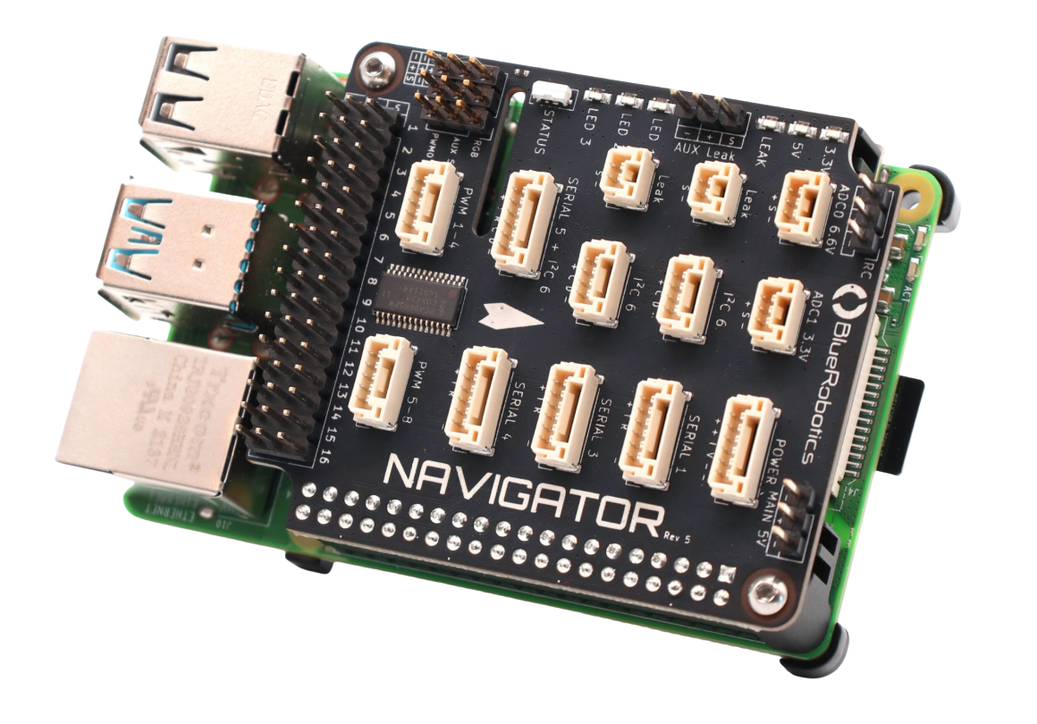
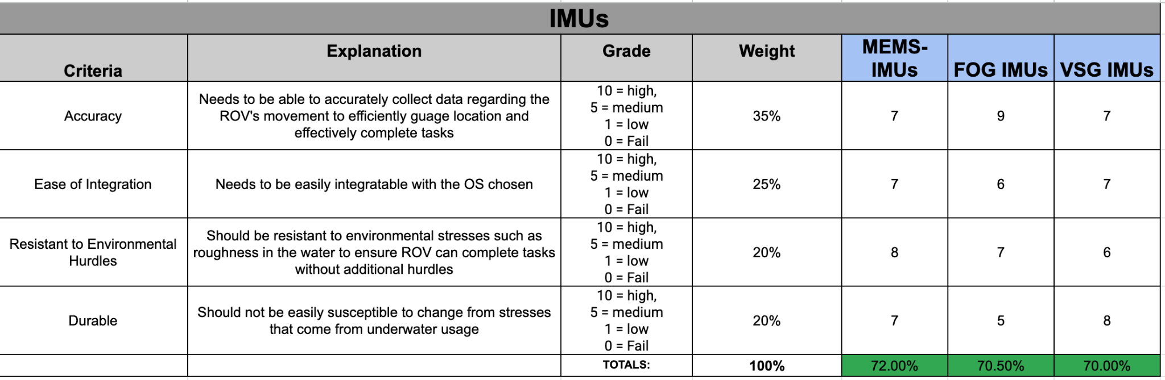
Inertial Measurement Unit
Compatible with BlueOS
Has more than IMU, compass and barometer
6 DOF
BlueRobotics Navigator
29

Slide 28
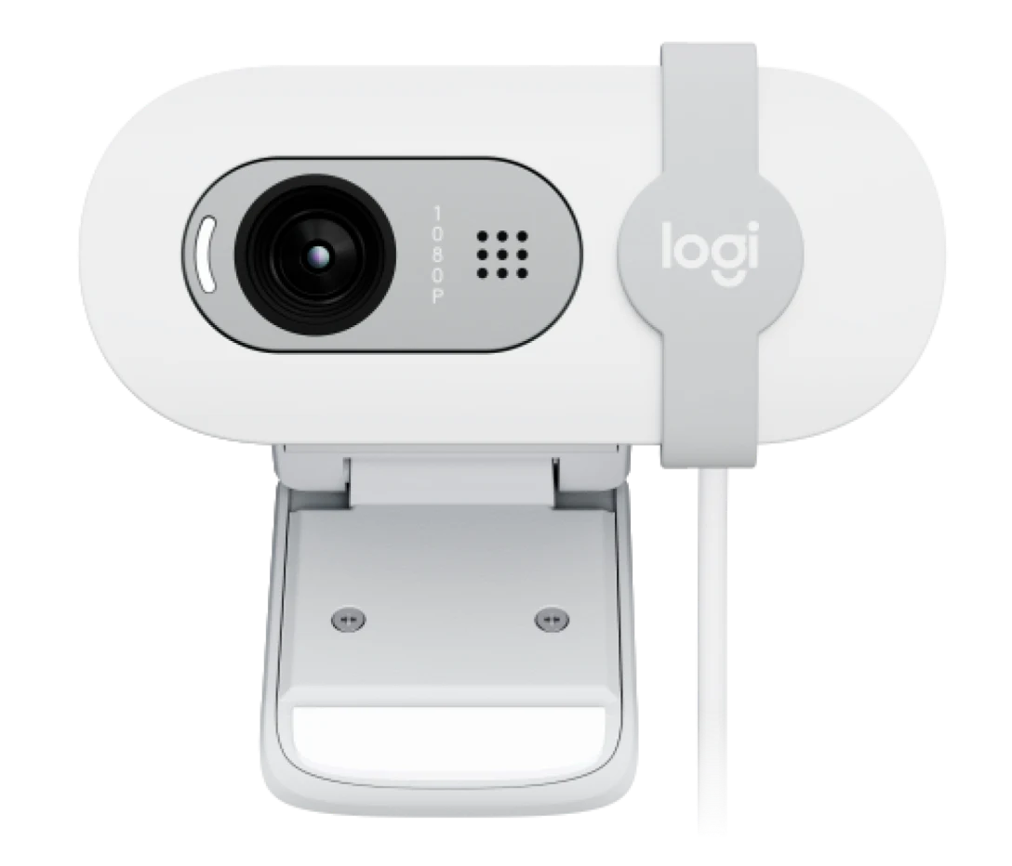
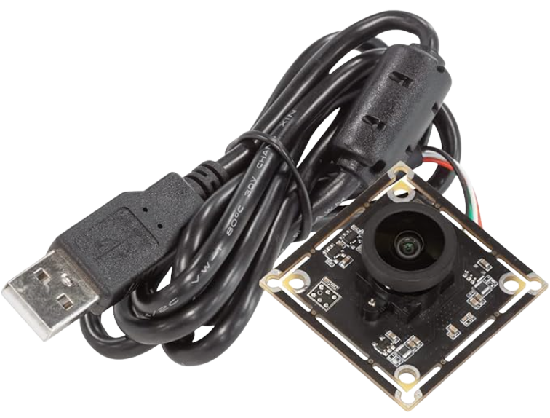
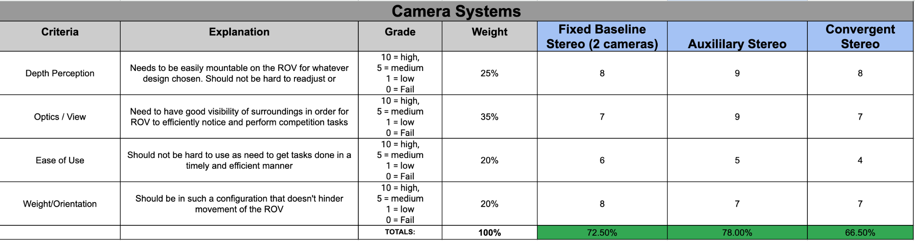
Camera
ArduCam 4K/BRIO 100
One camera (4K) for photogrammetry
12 MP, Max 15 fps, Photo mode
Other camera for video feed
1080p, 60 fps
30
Notes:
Having a dual camera system (auxiliary stereo). most commonly seen for ROVs due to good depth perception and optics. One for general navigation while the other is for more complex tasks like photogrammetry. Brio for general nav and ArduCam for complex tasks. will be connected to rasp pi

Slide 29
Computation and Communications (C&C)

Slide 30
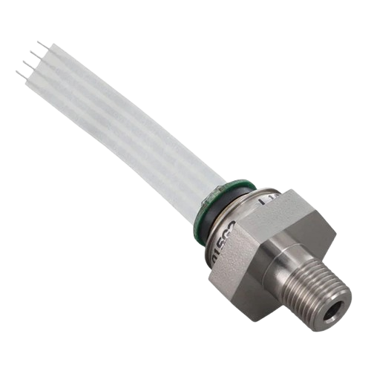
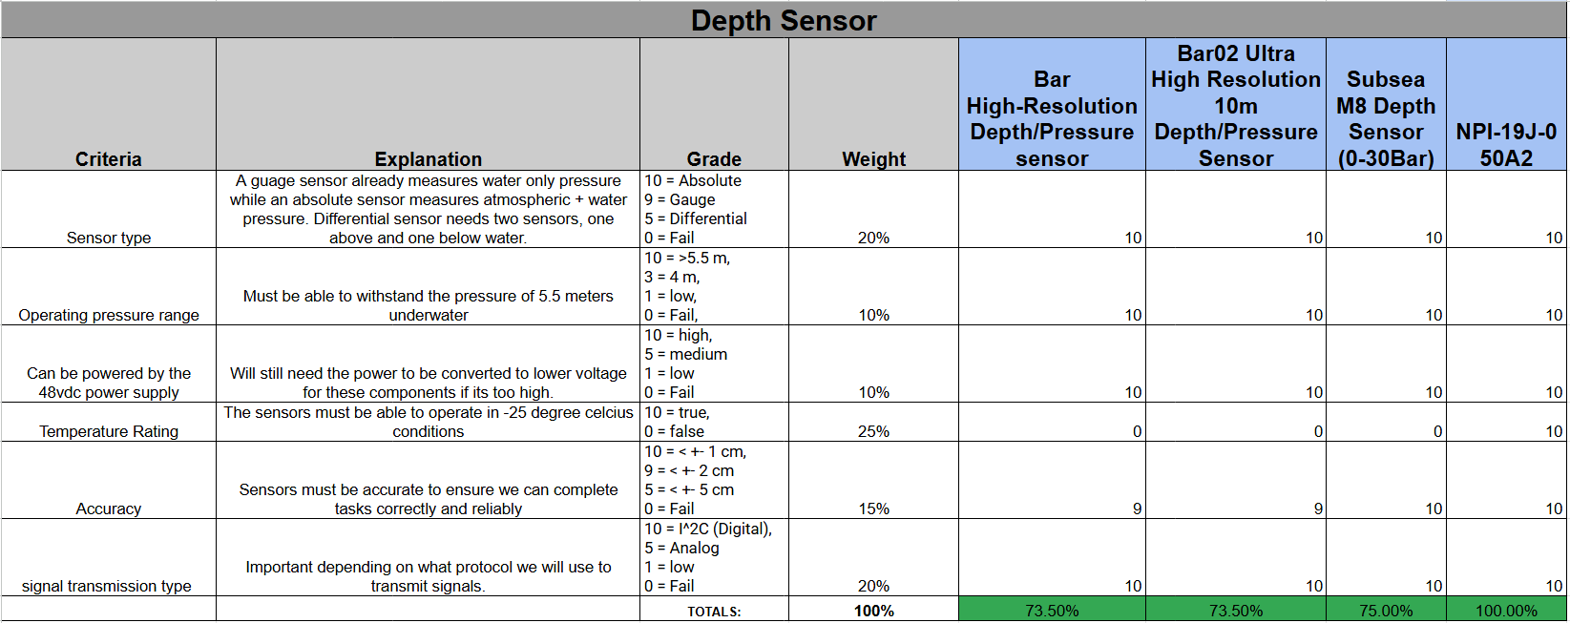
Pressure Sensor
Functional in temps >-40°C
Absolute sensor
2.5V~5.5V
32

Slide 31
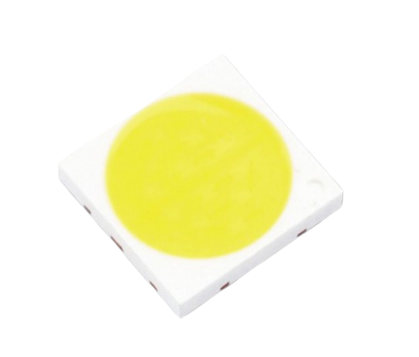
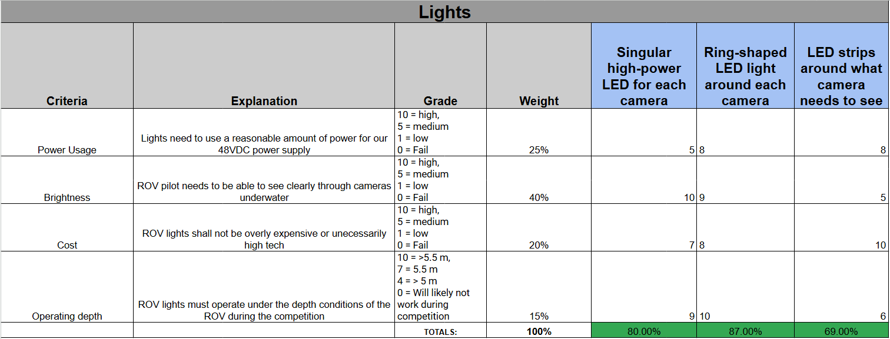
Lights
Diffused LEDs
Each side of camera
1430 lumens
12V
33

Slide 32
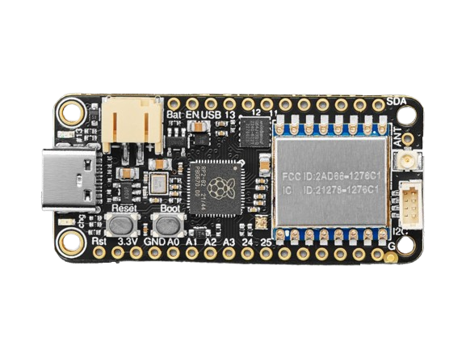
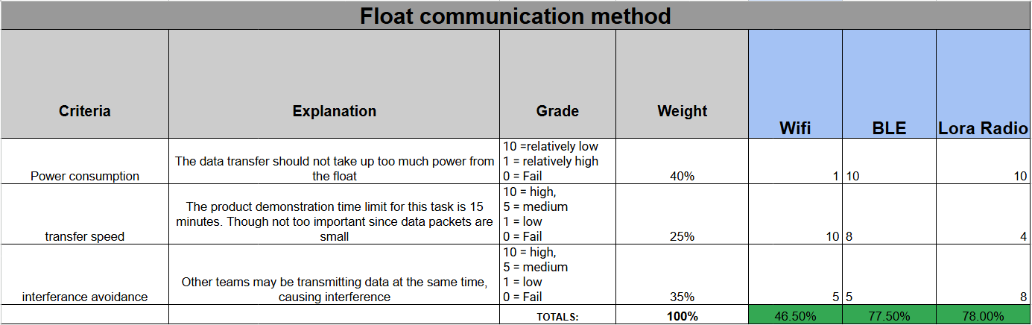
Adafruit Feather RP2040 LoRa Radio
Easily send data packets
Compatible with Raspberry Pi
1.8V~3.7V
34

Slide 33
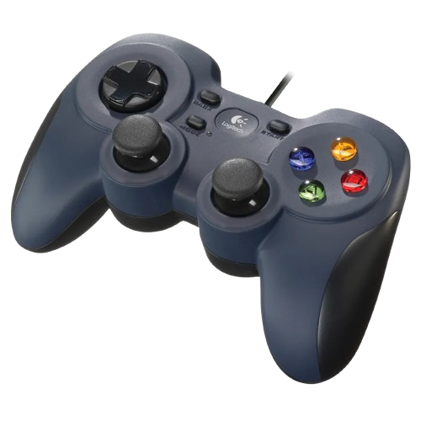
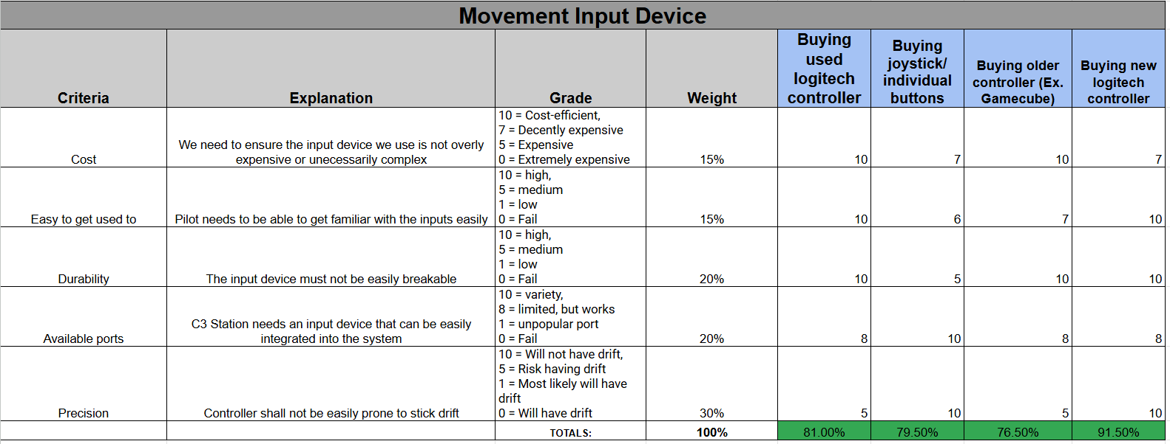
Logitech Controller for C3 Station
Cost-efficient ($10)
Easily programmable
35

Slide 34
Q&A
Thank you for your time!

Slide 35
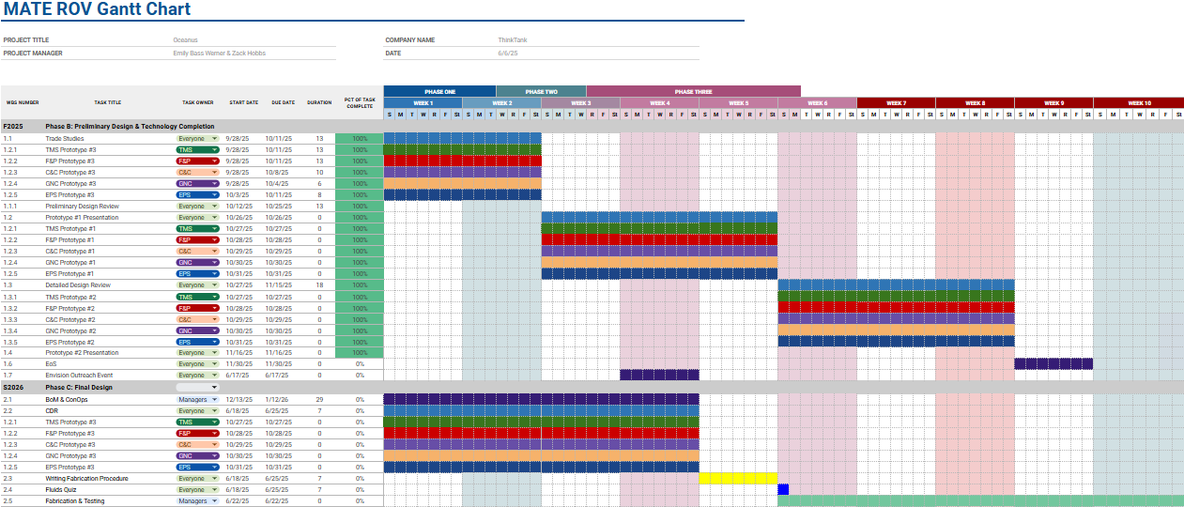
Appendix A: Gantt Chart

Slide 36
Appendix B
Bill of Materials:
Link
GitHub:
Link
Team Notebook:
Link
Oceanus SOP:
Link

Slide 37
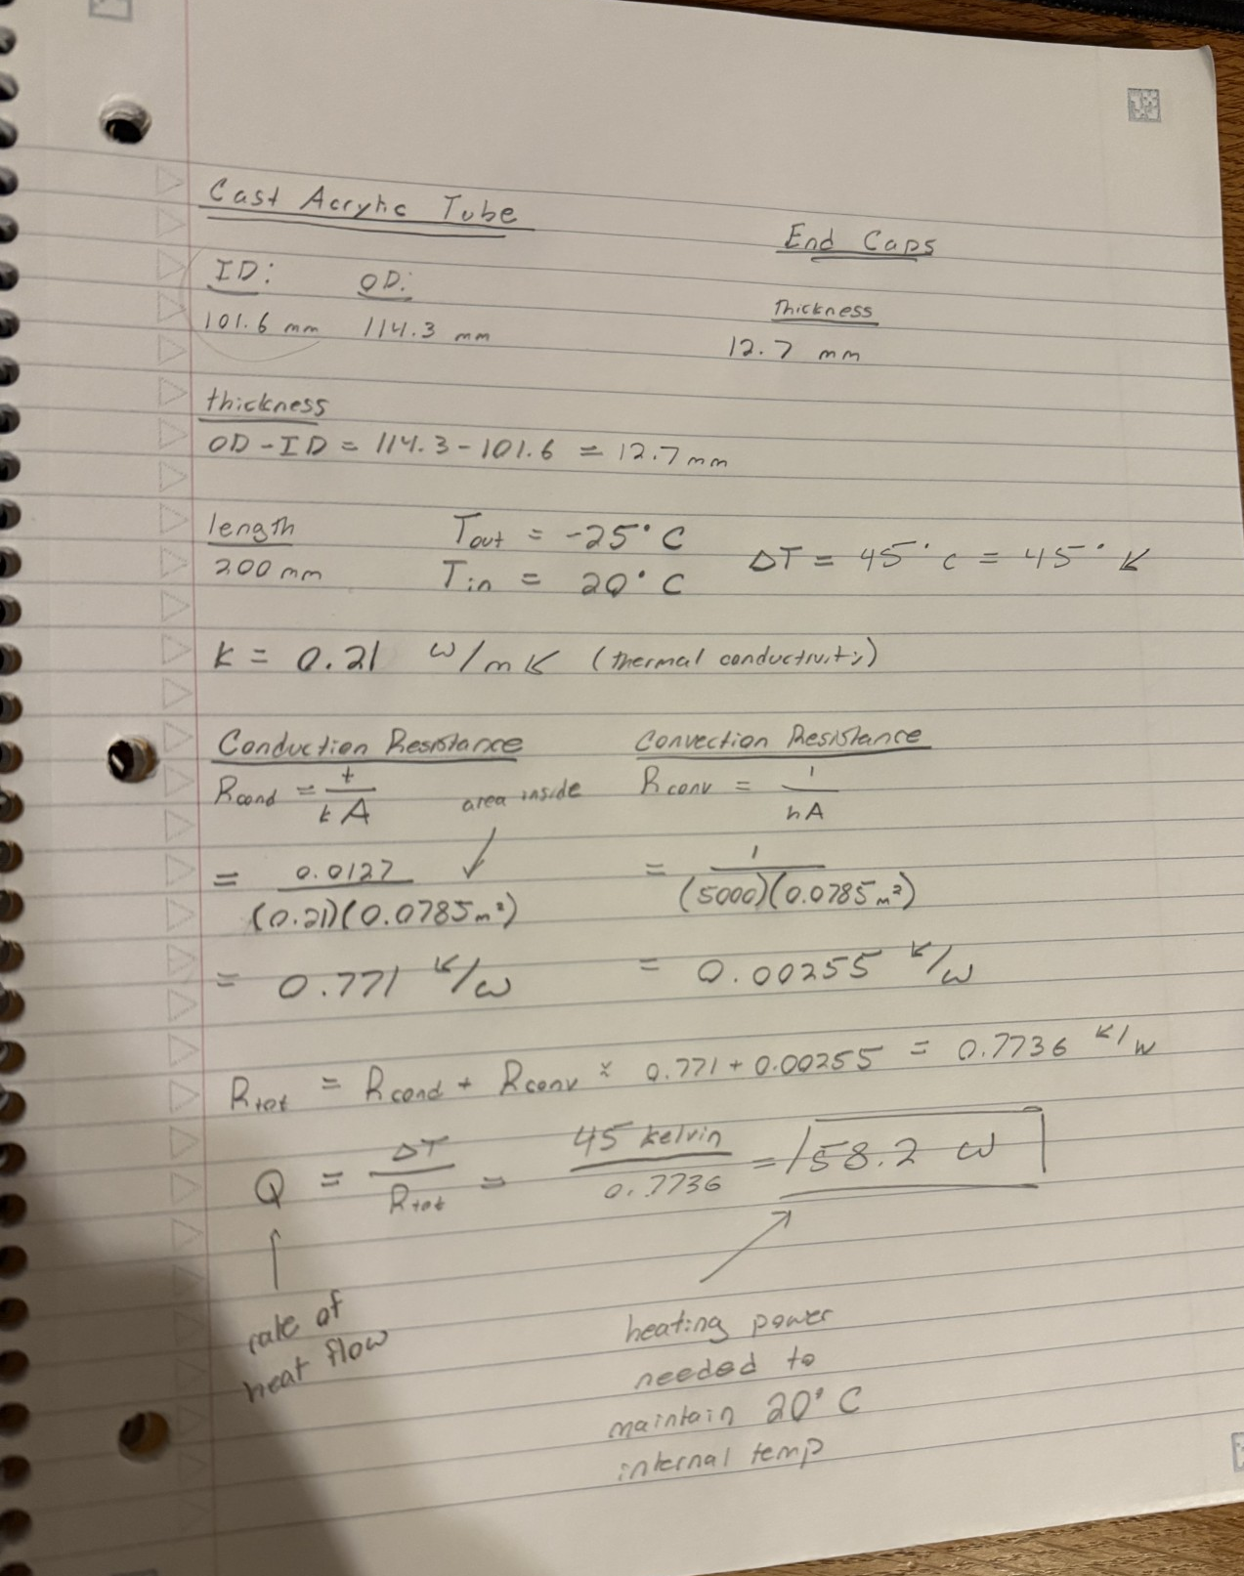
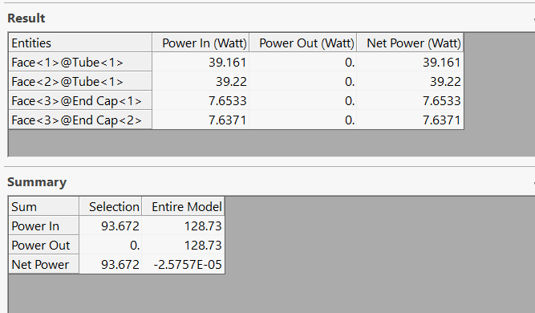
Appendix C

